Slide 1

ARTIFICIALLY INTELLIGENT
&
SOCIAL
BUILDING AUTOMATION SYSTEMS
ICAECS 2015
T.V.VIGNESH

Slide 2

AN OUTLINE
Introduction
The World Timeline
Control & Automation
Artificial Intelligence
Social Networking
The IDEA & Inspirations
The Way & Possibilities
Work Progress & Inference
Expected Outcome & Impact

Slide 3

INTRODUCTION
Building Automation Systems
An Abstract IDEA
Controlling, Monitoring & Automating devices
My work in this area

Slide 4
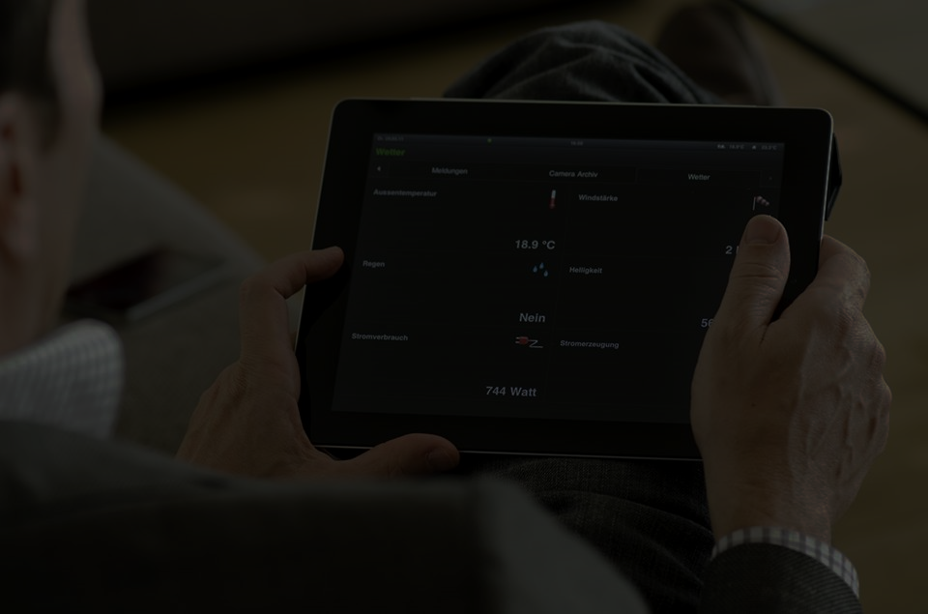
THE WORLD TIMELINE
No Control
Manual Control
Remote Control
Automation
Learn, Think & Act

Slide 5
Control & Automation
Controlling Devices
Sensing the System Parameters
Gathering User Needs
Automating the System

Slide 6
Artificial Intelligence
Learn
Think
Act

Slide 7
Social Networking
Personal, Career & Community Profiles
Circles (Friends, Family & Colleagues)
Conversations
Notifications, Reminders & Appointments

Slide 8

IDEA & Inspirations

Slide 9
The Way & Possibilities

Slide 10
MODULES INVOLVED
LIGHT CONTROL
LIGHT SENSING
TEMPERATURE & HUMIDITY SENSING
SWITCHING DEVICES
MOTION SENSING
AC-DC CONVERSION
DOOR SENSING
RF COMMUNICATION
USER INTERFACE & SERVER-DATABASE INTERGRATION

Slide 11

THE SYSTEM
RASPBERRY PI
POWER SYSTEM
ACTUATORS
USER INTERFACE
CHANNEL
POWER SUPPLY
ARDUINO SUBSTATION

Slide 12
CHANNEL
RF (NRF24L01+) AND Wi-Fi

Slide 13

BLOCK DIAGRAM
INTERNET CHANNEL
INDIRECT I/O
I/O INTERFACE
(DIRECT ACCESS)
CENTRALIZED
MICROPROCESSOR
(RASPBERRY PI)
Supporting Supply
RF CHANNEL
Sensors
Arduino Substation
Actuators
Plant

Slide 14
BLOCK DIAGRAM
Web Server
Microprocessor
(Raspberry PI)
Microcontroller
(Arduino)
Lighting
Security
Switching
User Interface
Safety

Slide 15
LIGHTING
USER INTERFACE
ARDUINO SUBSTATION
CHANNEL - RF
RASPBERRY PI 2 BASE STATION
CHANNEL - INTERNET
PWM OUTPUT ADJUSTED BY P CONTROLLER
AMPLIFICATION AND FILTER CIRCUITS
DIGITAL BALLAST
LIGHT FIXTURE
LIGHT SENSOR

Slide 16
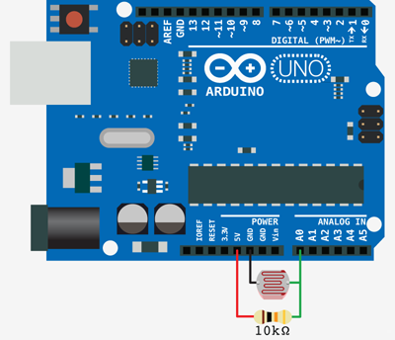
LIGHT SENSING

Slide 17
SWITCHING DEVICES
USER INTERFACE
ARDUINO SUBSTATION
CHANNEL - RF
RASPBERRY PI 2 BASE STATION
CHANNEL - INTERNET
GPIO OUTPUT
ELECTRONIC RELAY
POWER SYSTEM DEVICE

Slide 18
POWER SUPPLY CONVERSION
220V AC MAINS
AMPLIFIER SUPPLY
TWO LM7812 VOLTAGE REGULATORS
BRIDGE RECTIFIER
12V AC STEP DOWN TRANSFORMER

Slide 19
RF COMMUNICATION
USER INTERFACE
ARDUINO SUBSTATION
RF TRANSCEIVER (PI SIDE)
RASPBERRY PI 2 BASE STATION
CHANNEL - INTERNET
GPIO OUTPUT
RF TRANSCEIVER (ARDUINO SIDE)

Slide 20
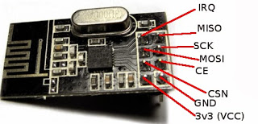
RF COMMUNICATION

Slide 21
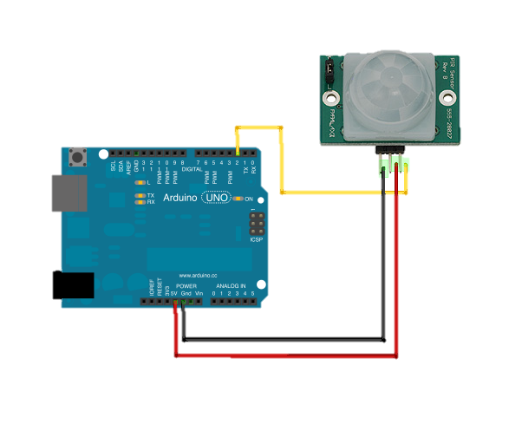
MOTION SENSING (PIR SENSOR)

Slide 22

DOOR SENSING (REED RELAY)

Slide 23
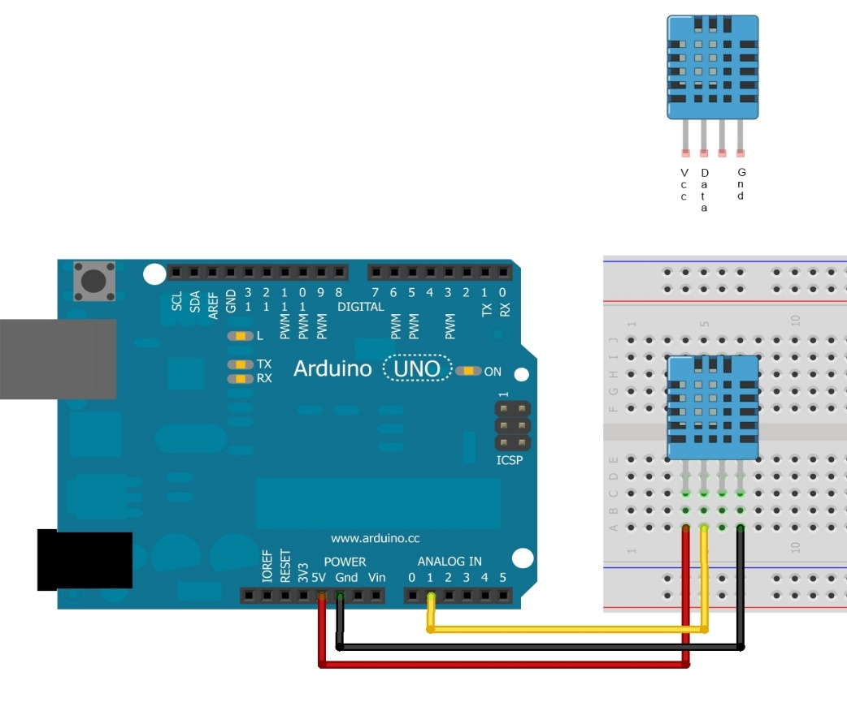
TEMPERATURE & HUMIDITY SENSING

Slide 24
SWITCHING DEVICES

Slide 25

HARDWARE DETAILS
Raspberry PI 2 Model B
&
ARDUINO
Connectors & Board
Wi-Fi Dongle & Xbee
SENSORS
RESISTORS
CAPACITORS
TRANSISTORS
RELAYS
RECTIFIERS & ACTUATORS
ADC
STEP DOWN TRANSFORMER
I/O DISPLAY
DIODES
DC-DC BOOST CONVERTER
DC POWER SUPPLY

Slide 26
HARDWARE DETAILS
SENSORS
Light
Temperature
Motion
Humidity
Door
Smoke

Slide 27

SOFTWARE DETAILS
HTML
CSS
JAVASCRIPT & JQUERY
PHP
MySQL
PYTHON
LINUX SHELL
C++

Slide 28
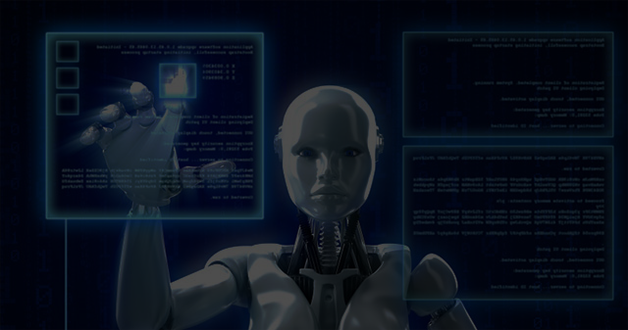
EXPECTED OUTCOME

